Slide 1
Chapter 3: Demand, Supply and Equilibrium
From Chapter 2: All societies must decide:
  What will be produced?
  How will it be produced?
  Who will get what is produced?
In a laissez-faire economy: individual people and firms pursue their own self-interests without any central direction or regulation. The central institution of a laissez-faire economy is the free-market system.
A market is the institution through which buyers and sellers interact and engage in exchange.

Slide 2
Demand Schedule
A demand schedule is a table showing how much of a given product a household would be willing to buy at different prices. It is a list of prices and the associated quantities demanded.

Slide 3
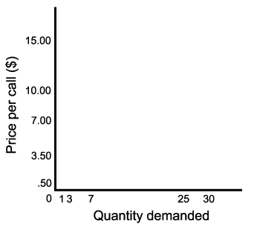
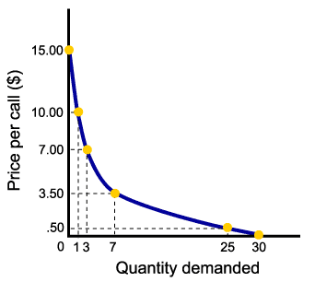
The Demand Curve
The demand curve is a graph illustrating how much of a given product a household would be willing to buy at different prices.
Demand curves intersect the (Y)-axis, as a result of limited incomes and wealth.

Slide 4
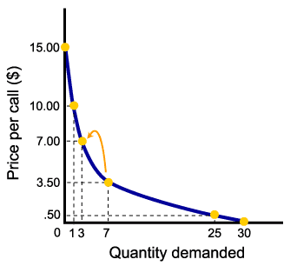


The Law of Demand
The law of demand states that there is a negative, or inverse, relationship between price and the quantity of a good demanded, ceteris paribus.
Why is the relationship negative?
Why do we need the ceteris paribus assumption?

Slide 5
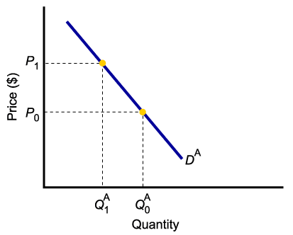
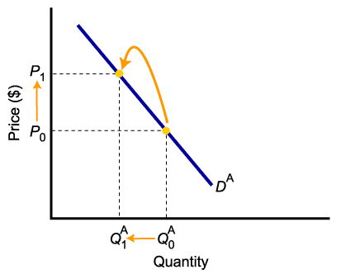
Shift of Demand Versus Movement Along a Demand Curve
A “change in demand” is not the same as a “change in quantity demanded.”
A higher price causes a lower quantity demanded. This is shown here: price increases from P_{o} to P₁, causing quantity demanded to fall from Q_{o}^{A} to Q₁^{A}.
We do not say that a higher price causes a lower demand.

Slide 6
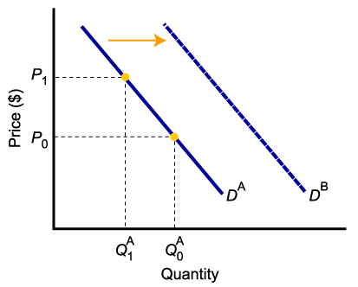
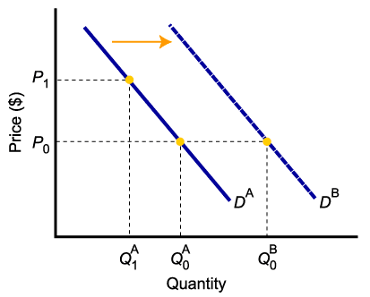
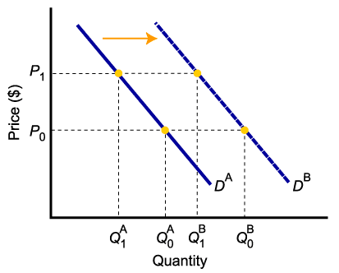
A Change in Demand Versus a Change in Quantity Demanded
An “increase in demand” is captured with a shift of the demand curve to the right: quantity demanded is greater than it was prior to the shift, for each and every price level.
Changes in determinants of demand, other than price, cause a change in demand, or a shift of the entire demand curve, from D^{A} to D^{B}.

Slide 7
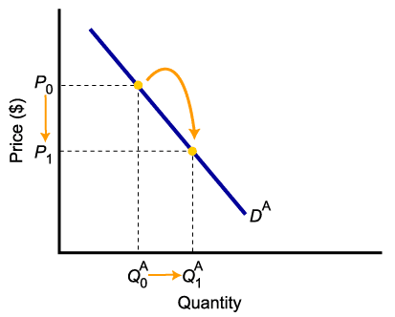
A Change in Demand Versus a Change in Quantity Demanded
To summarize:
Change in price of a good or service
leads to
Change in quantity demanded
(Movement along the curve).
Change in income, preferences,
prices of other goods or services,
or expectations leads to
Change in demand
(Shift of curve).

Slide 8
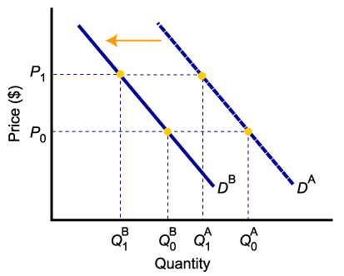
The Impact of a Change in Income
Higher income decreases the demand for an inferior good
Higher income increases the demand for a normal good

Slide 9
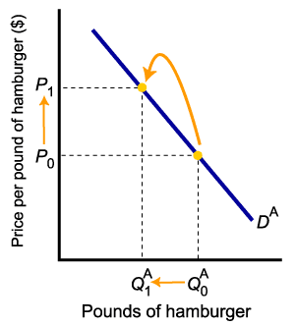
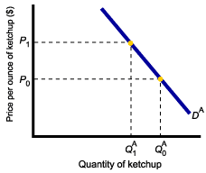
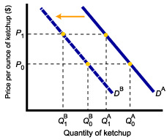
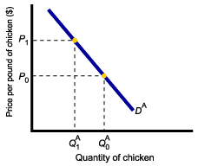
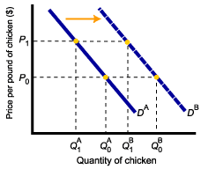
The Impact of a Change in the Price of Related Goods
2. Demand for complement good (ketchup) shifts left
3. Demand for substitute good (chicken) shifts right
1. It all starts with:
The Price of hamburger rises →
Quantity of hamburgers demanded falls

Slide 10
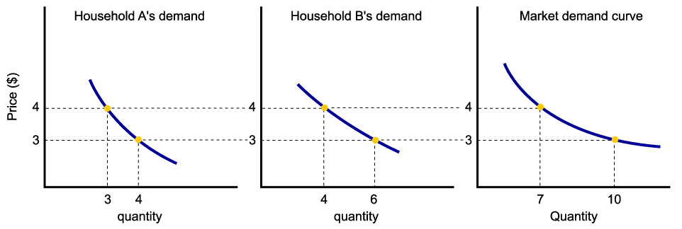
From Household to Market Demand
Demand for a good or service can be defined for an individual household, or for a group of households that make up a market.
Market demand is the sum of all the quantities of a good or service demanded per period by all the households buying in the market for that good or service.
Assuming there are only two households (A and B) in the market, market demand is derived as follows:

Slide 11
Supply in the Output Markets
Firms produce goods and services and sell them in the output markets
In a free market system, firms operate under the motivation of maximum profit.
Start with the idea of a small firm operating in a large market. It must decide what quantity to offer for sale in the market. It doesn’t set price.
Profits = Revenues – Costs

Slide 12
Supply in Output Markets
Quantity supplied represents the number of units of a product that a firm would be willing and able to offer for sale at a particular price during a given time period.
Determinants of quantity supplied (q_{s}):
  Price
  Costs of production:
    The price of required inputs (labor, capital, and land)
    The technologies that can be used to produce the product
  Prices of Related Goods (related in production)

Slide 13
Supply in Output Markets
A supply schedule is a table showing how much of a product firms will supply at different prices.

Slide 14
The Supply Curve and the Supply Schedule
A supply curve is a graph illustrating how much of a product a firm will supply at different prices.
S

Slide 15

The Law of Supply
The law of supply states that there is a positive relationship between price and quantity of a good supplied, ceteris paribus.
This means that supply curves typically have a positive slope.
Why ceteris paribus?
S

Slide 16
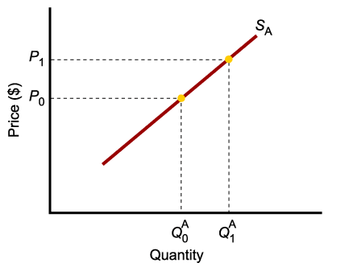
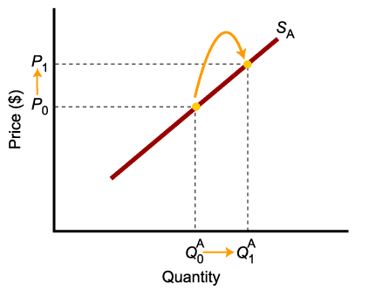
A Change in Supply Versus a Change in Quantity Supplied
A “change in supply” is not the same as a “change in quantity supplied.”
A higher price causes a larger quantity supplied. This is shown here with price increasing from P_{o} to P₁, causing quantity supplied to increase from Q_{o}^{A} to Q₁^{A}.
We do not say that a higher price causes a larger supply.

Slide 17
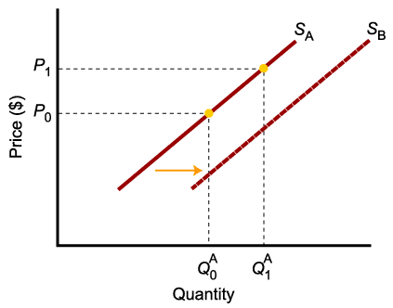
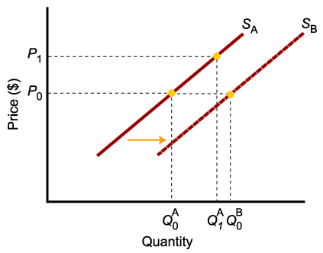
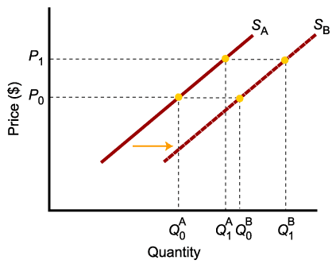
A Change in Supply Versus a Change in Quantity Supplied
An “increase in supply” is captured with a shift of the supply curve to the right: quantity supplied is greater than it was prior to the shift, for each and every price level.
Changes in determinants of supply, other than price of the product, cause a change in supply, or a shift of the entire supply curve, from S^{A} to S^{B}.

Slide 18

A Change in Supply Versus a Change in Quantity Supplied
To summarize:
Change in price of a good or service
leads to
Change in quantity supplied
(Movement along the curve).
Change in costs, input prices, technology, or prices of related goods and services
leads to
Change in supply
(Shift of curve).

Slide 19
From Individual Supply to Market Supply
The supply of a good or service can be defined for an individual firm, or for a group of firms that make up a market or an industry.
Market supply is the sum of all the quantities of a good or service supplied per period by all the firms selling in the market for that good or service.

Slide 20
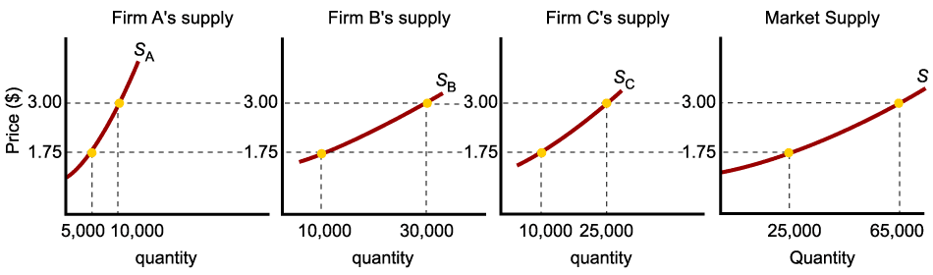
Market Supply
As with market demand, market supply is the horizontal summation of individual firms’ supply curves.

Slide 21
Market Equilibrium
The operation of the market depends on the interaction between buyers and sellers.
An equilibrium is the condition that exists when quantity supplied and quantity demanded are equal.
At equilibrium, there is no tendency for the market price to change.

Slide 22
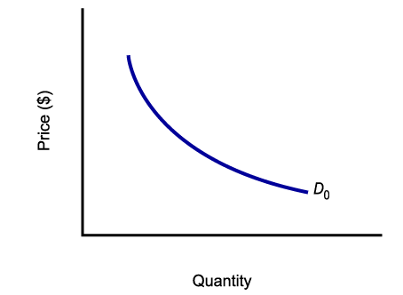
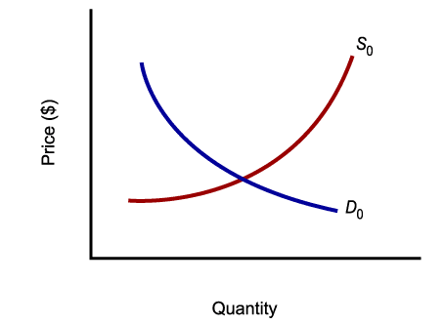
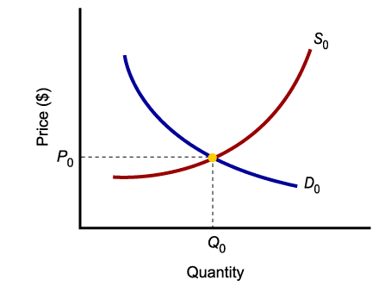
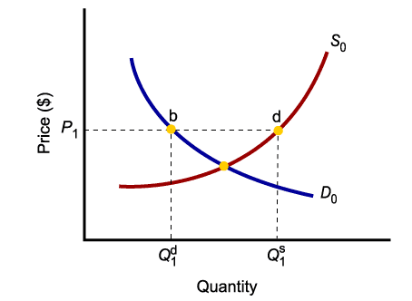
Market Equilibrium
Equilibrium is where quantity supplied equals quantity demanded:
Specifically, it is the price where
Q_{D} = Q_{S}
(not where demand = supply)
At any price level other than P₀, the wishes of buyers and sellers do not coincide → disequilibirum

Slide 23
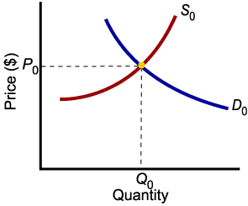
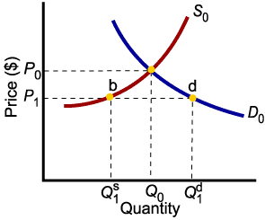
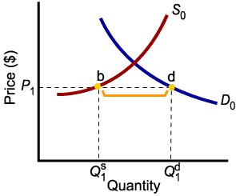
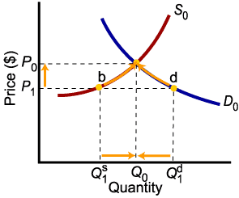
Market Disequilibria
Excess demand, or shortage, is the condition that exists when quantity demanded exceeds quantity supplied at the current price:
At P₁, Q₁^{D} > Q₁^{S}
Price rationing: “as long as there is a way for buyers and sellers to
Interact, those who are willing and able to pay more will make
that fact known”

Slide 24
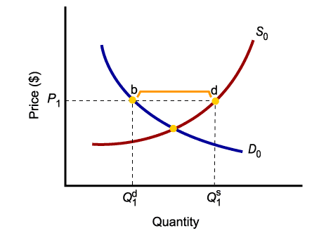
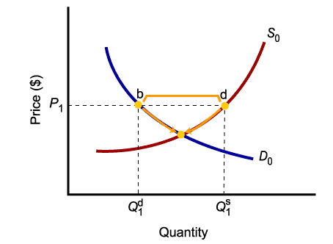
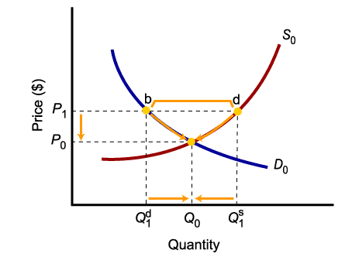
Market Disequilibria
Excess supply, or surplus, is the condition that exists when quantity supplied exceeds quantity demanded at the current price:
At P₁, Q₁^{S} > Q₁^{D}

Slide 25
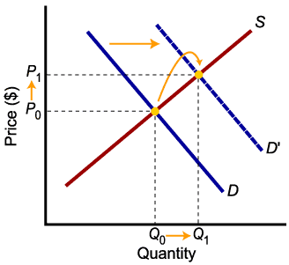
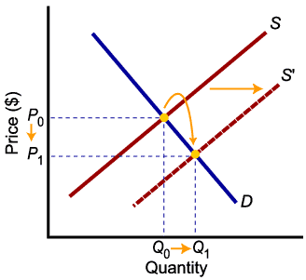
Changes in Equilibrium: Increases in Demand and Supply
An increase in demand leads to higher equilibrium price and higher equilibrium quantity.
An increase in supply leads to lower equilibrium price and higher equilibrium quantity.

Slide 26
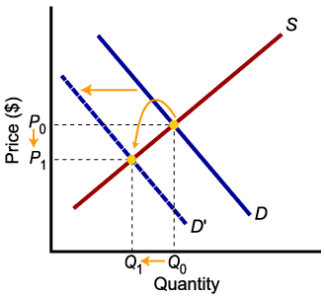
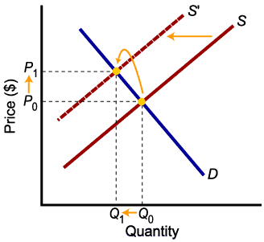
Changes in Equilibrium: Decreases in Demand and Supply
A decrease in demand leads to lower price and lower quantity exchanged.
A decrease in supply leads to higher price and lower quantity exchanged.

Slide 27


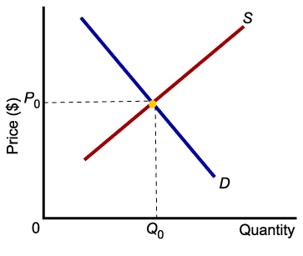
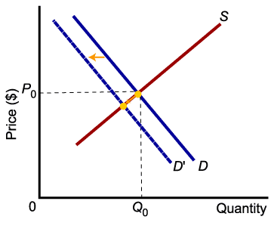
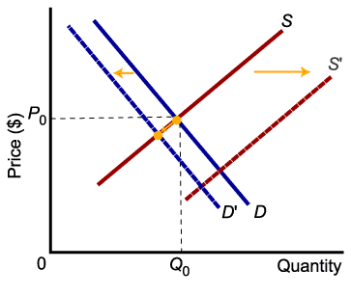
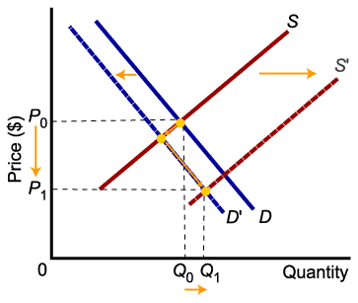
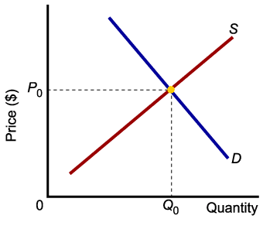
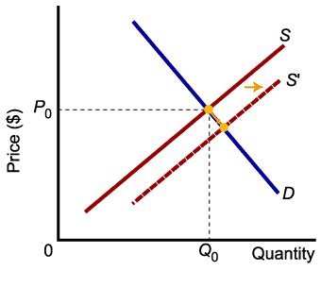
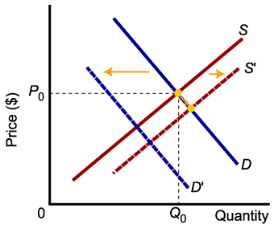
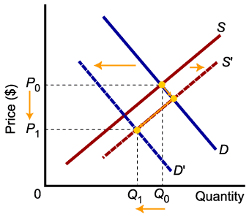
Relative Magnitudes of Change
The relative magnitudes of change in supply and demand determine the outcome of market equilibrium.

Slide 28


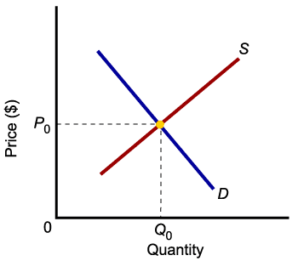
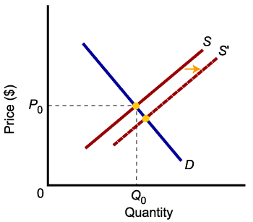
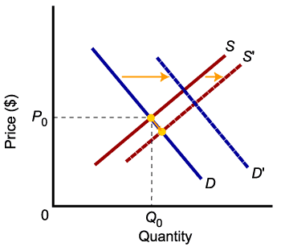
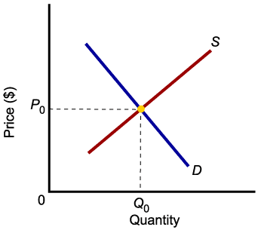
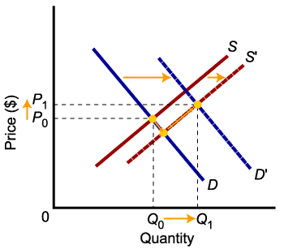



Relative Magnitudes of Change
When supply and demand both increase, quantity will increase, but price may go up or down.

